Slide 1
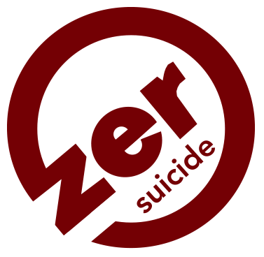

Washington County Zero Suicide Program
Annual Report
Executive Summary
FY 2022

Slide 2
WCZSP County-Wide Leadership Team
Stakeholder Engagement
Block Island Library
Block Island Medical Center
Chariho Youth Task Force
Charlestown Recreation Center
Chris Collins Foundation
Gateway Healthcare
Hope Recovery Center
South County Health
The Warren Alpert Medical School of Brown University
Thundermist Health Center
URI Health Services
Wakefield Baptist Church
WellOne
Westerly Basic Needs Network
Westerly Hospital
Wood River Health Services

Slide 3
Host Organization | Number of Trainees
Barrier Breakers Youth Initiative | 1
Block Island - Community | 10
Block Island Library | 2
Charlestown Recreation | 41
Christ the King Church | 14
Commercial Fisheries | 10
Davisville Community | 2
Lifespan | 1
Marigold Health | 1
Meadowbrook | 33
New England Institute of Technology | 2
North Kingstown Police | 48
Parent Support Network of Rhode Island | 24
South County Hospital | 428
Southern RI Volunteers | 14
St Andrew's Church | 12
Thrive Behavioral Health | 1
Town of Charlestown | 2
University of Rhode Island | 18
Washington County - Community | 18
WellOne | 12
Westerly Hospital | 73
Wood River Health Services | 37
YMCA-Mystic | 10
Grand Total | 814
QPR Trainings
Question Persuade Refer Suicide Prevention Training
From September 30, 2021 to
September 29, 2022, the WCZSP trained
814 individuals from 25 organizations
428 Staff trained at South County Health alone

Slide 4

Students rated QPR trainings very highly 98% (n=81) of evaluation respondents rated the training “excellent” or “very good” In response to the question, “Would you recommend this training to others?” 100% (n= 98) said “yes”
What people are saying about QPR!

Slide 5
More Trainings to Develop Competent Workforce
More Than Sad: Suicide Prevention for Parents
Approximately 20 participants joined each session (live)
Micro-interventions to Support Those Escaping Emotional Pain: Addressing Overlapping Substance Use and Suicide Risk
111 Behavioral Health Clinicians (attended the live session)
48 Behavioral Health Clinicians (watched on-demand)
Columbia Suicide Severity Rating Scale- Mini- Trainings
77 Direct care staff (Nurses and Doctors)
Online trainings provided to behavioral health staff: DBT Skills with Marsha Lineham, QPR Institute Pathfinder Training, and Wellness Recovery Action Planning

Slide 6
Universal Screenings Conducted
68,155 C-SSRS (Columbia-Suicide Severity Rating Scale and PHQ (Public Health Questionnaire) patient screens for depression and suicidality conducted by our partners:
South County Hospital
Westerly Hospital
Gateway Healthcare
Thundermist Health Center
WellOne Primary Medical & Dental Care
Wood River Health Services

Slide 7
Bridging Transitions: Peer Recovery Specialist
WCZSP Peer Recovery Specialist (PRS) supported 50 individuals this FY
PRS referrals received from South County Health, Wood River Health, Gateway, Block Island Medical Center, and Westerly Hospital
PRS conducted these support groups (both in person & virtually):
Wellness Recovery Action Plan (WRAP) Group
Survivors of Suicide Attempt (SOSA) Group

Slide 8

Data Collection
Through an ongoing relationship with the Rhode Island Department of Health, we obtain quarterly updates suicide and suicide attempt surveillance data to help guide our efforts

Slide 9

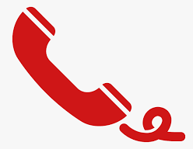
Man Therapy Online Engagement
Since the WCZSP launch Man Therapy campaign more than 1,408 1,505 unique users from Washington County visited the Man Therapy website (from 10/1/2021 – 9/29/2022)
Users spent an average of 1:25 seconds on the Man Therapy website
254 (7%) users completed the 20-point Head Inspection
Topics explored by users included depression & suicide
(79), anxiety (70), relationships & sex (53), anger (42) and
sleep (35)
5 website visitors clicked the red phone,
which provides users with the National Suicide
Prevention Lifeline phone number & chat feature

Slide 10
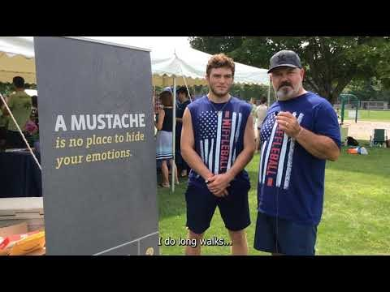
Mustache Moment

